Slide 1
Adult Education & Literacy
Advisory Committee Meeting
(Virtual)
Wednesday June 21st, 2023
1:30 pm CST

Slide 2
June 21st, 2023
Agenda
TWC Welcome / Opening Remarks
TWC AEL Updates
  TWC Adult Education and Literacy updates
III. Committee Business Discussion
  Guest Speaker – Pooja Tripathi
  Guest Speaker- Adrian Lopez

Slide 3
Opening Remarks
Welcome To Our Newest Members!
Cindy Fisher –State Broadband Office
Dr. Ben Stafford –Lamar College
Kristina Hartman –Windham School District

Slide 4
Commissioner Remarks
Chairman Daniel
Commissioner Demerson
Commissioner Trevino

Slide 5
TWC AEL Updates

Slide 6
Legislative Update
HB 1602 –Signed
Relating to performance criteria for the award of adult education and literacy funds.
Notes:
The bill requires TWC to establish annual performance requirements that Adult Education and Literacy (AEL) program providers must satisfy to qualify for a continuing award of AEL funds. Performance requirements are required to include the achievement of enrollment targets and performance benchmarks that are comparable to those provided under statutory performance incentive funding provisions, which include: the enrollment in a high school equivalency program or a postsecondary ability to benefit program of at least 25 percent of all students receiving AEL services from the entity during that program year; and, the achievement by the end of the program year of a high school equivalency cetificate or postsecondary certificate by at least 70 percent of the AEL program's exiters. The bill requires that TWC establish a process for giving priority in awarding AEL funds to entities that consistently satisfy annual performance requirements.

Slide 7
SB 2032 - Signed
Relating to adult high school charter school programs
Notes:
The bill expands the entities eligible to operate an adult education charter program to include the following entities, if the entity meets other applicable requirements: a public school district; an entity granted an open-enrollment charter; or, a general academic teaching institution, public junior college, or public technical institute.

Slide 8
SB 2139- With Governor
Relating to the establishment of the Opportunity High School Diploma program
Notes:
The bill establishes a new Opportunity High School Diploma program to provide an alternative means by which adult students enrolled in a workforce education program at a public junior college may earn a high school diploma at the college through concurrent enrollment in a competency-based education program that enables students to demonstrate knowledge substantially equivalent to the knowledge required to earn a high school diploma in Texas. THECB is required to administer the program in consultation with TEA and TWC. Public junior colleges may submit applications to THECB to participate in the program; THECB may choose up to five public junior colleges to participate.

Slide 9
Request for Information (RFI)
RFI posted to collect information on the next statewide AEL competition
Available on the Texas Electronic State Business Daily/ Tx Smart Buy
Request for Information (RFI) 320-24-00051 Related to AEL Core Provider Grant

Slide 10
AEL Advisory Committee
Member | Location | Representing | Affiliation | Term Expires
Steve Banta (Presiding Officer) | Dallas/ Fort Worth | Nonprofit | Executive Director, Literacy Texas | December 2023
Dr. Ben Stratford | Port Arthur | Higher Education | Vice President, Workforce and continuing Education | May 2025
Jauneen Maldonado | Fort Worth | Workforce Board | Director, Adult Education, Workforce Solutions for Tarrant County | December 2023
Cindy Fisher | Austin | Texas Broadband Office | Senior Coordinator, Texas Broadband Office | May 2025
Leslie Cantu | San Antonio | Business | Asst. Vice President – Toyotesu | October 2024
Kristina Hartman | Huntsville | Corrections Education | Superintendent, Windham School District | May 2025

Slide 11
Guest Speaker
Pooja Tripathi
Director, Workforce Initiatives
Manufacturing Institute

Slide 12

Fame USA

Slide 13
Pooja Tripathi
Director, Workforce Initiatives
Manufacturing Institute
Texas Workforce Commission
Adult Education and Literacy Committee
June 21, 2023

Slide 14
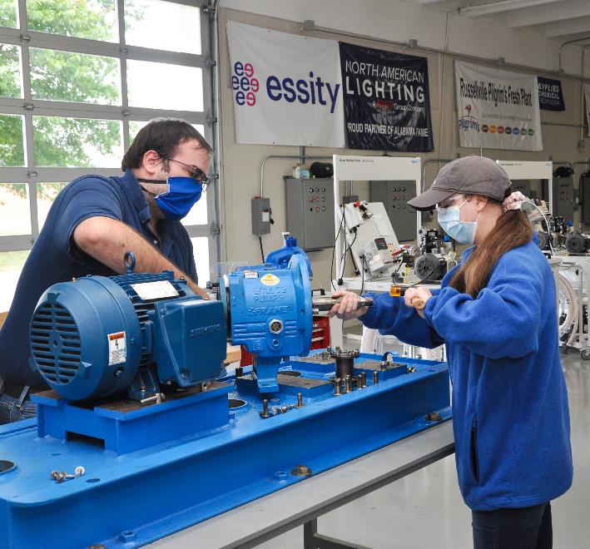
What is “FAME”?
Acronym…Model…Network
Advanced Manufacturing Technicians (AMTs) are global-best, entry-level multiskilled maintenance technicians.
The model uses
  A specific academic foundation
  Intensive, consistent reinforcement of distinct professional behaviors and practices
  Deep integration of core competencies in manufacturing
  On-site, intentional work/train experience for five semesters
AL FAME – Muscle Shoals
© Manufacturing Institute 2022

Slide 15
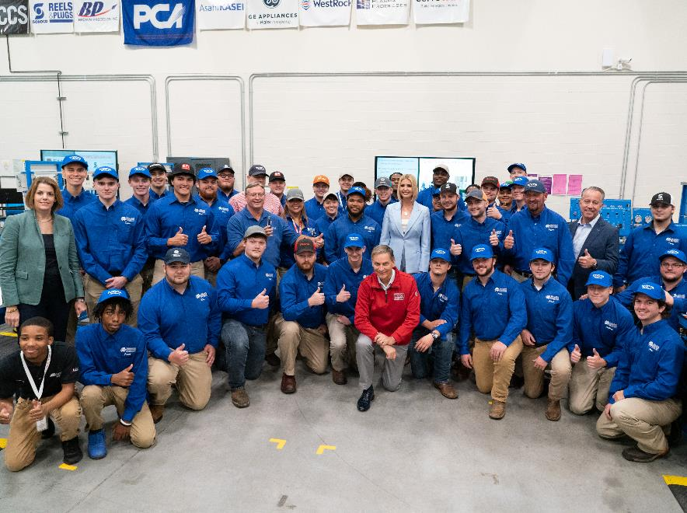
Timeline
2010
2012
2017
2019
2023
Program Starts in KY
First graduates
Has expanded across KY
Has expanded to all Toyota sites
Toyota transitions program to the MI in August
1,500 graduates
1,000 enrolled
Notes:
Toyota developed the origins of the program (“phase 1”) in 1987. They continuously improved the program internally, ultimately creating the FAME model (“phase 4”) before expanding to other companies in 2010, which would later be referred to as the first FAME Chapter.
Demand for the program grew as awareness spread over the next several years
Toyota recognized the model deserved a national platform which led to the transition to the Manufacturing Institute (MI) as the national platform in 2019

Slide 16
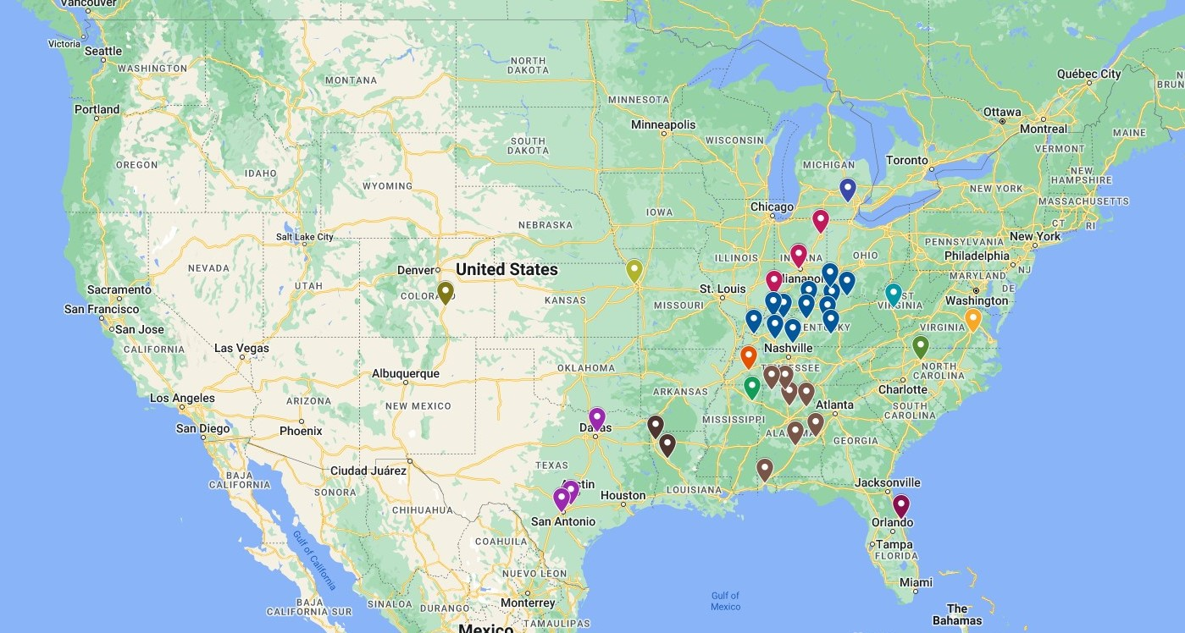
FAME Network
425+ Sponsoring Companies
37 Chapters
14 States
© Manufacturing Institute 2022
Notes:
Inherited 22 chapters, 2019
Started one chapter, 2020 (23)
Started nine chapters 2021 (31)
Starting five chapters, 2022 (36)
Expecting eight to enroll in Academy, 2022 (42)

Slide 17
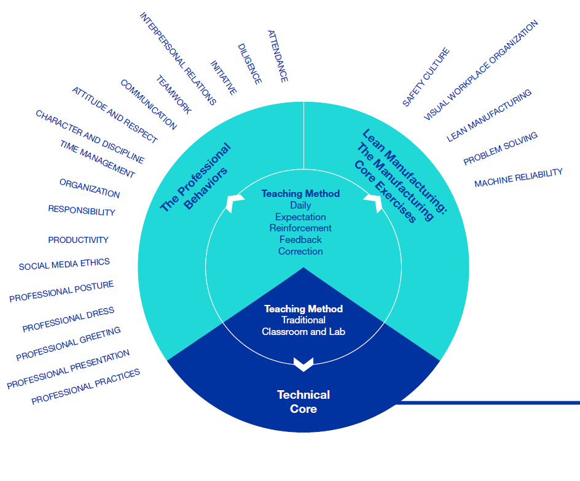
The FAME Model
Technical knowledge through pursuit of Associate degree
Specific Lean manufacturing knowledge overlaid on technical skills
Deep integration of Professional Behaviors through delivery of Lean elements
Notes:
Paid work/study co-op model
3 days working, 2 days at school creates “40-hour week”
Program starts each fall, runs five consecutive semesters
AMTs earn a FAME Certificate, encompassing:
an associate degree, with academic emphasis (no failing grades)
1,800 work hours, professional behaviors, lean elements

Slide 18
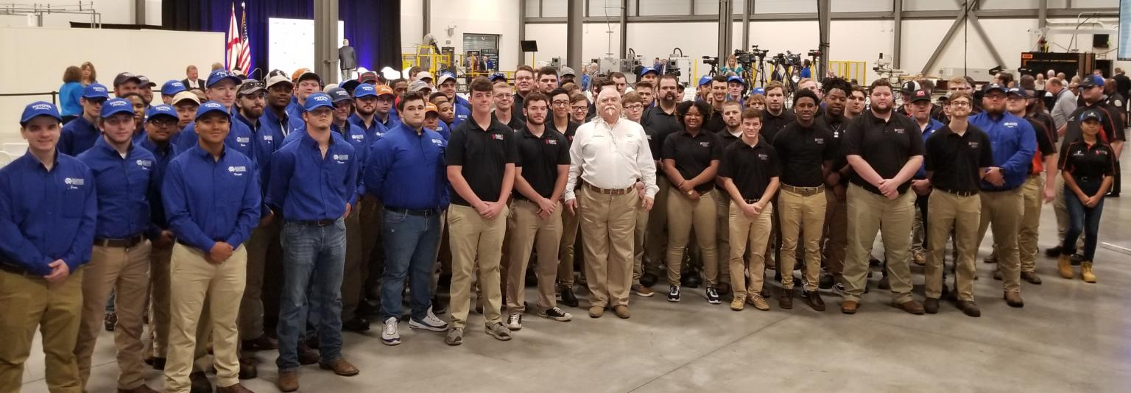
Look Professional,
Become Professional
Professionalism
Professional Behaviors Professional Practices Essential Behaviors
Manufacturing Core Exercises
Safety Culture Visual Workplace Organization Lean Principles & Practices
Problem Solving Machine Reliability
Technical Education
Multiskilled Curriculum Leading to Associate Degree
Electrical Mechanical Fluid Power Fabrication PLC/HMI Robotics
AL FAME - Rocket City
1st and 2nd Year AMTs
© Manufacturing Institute 2022

Slide 19
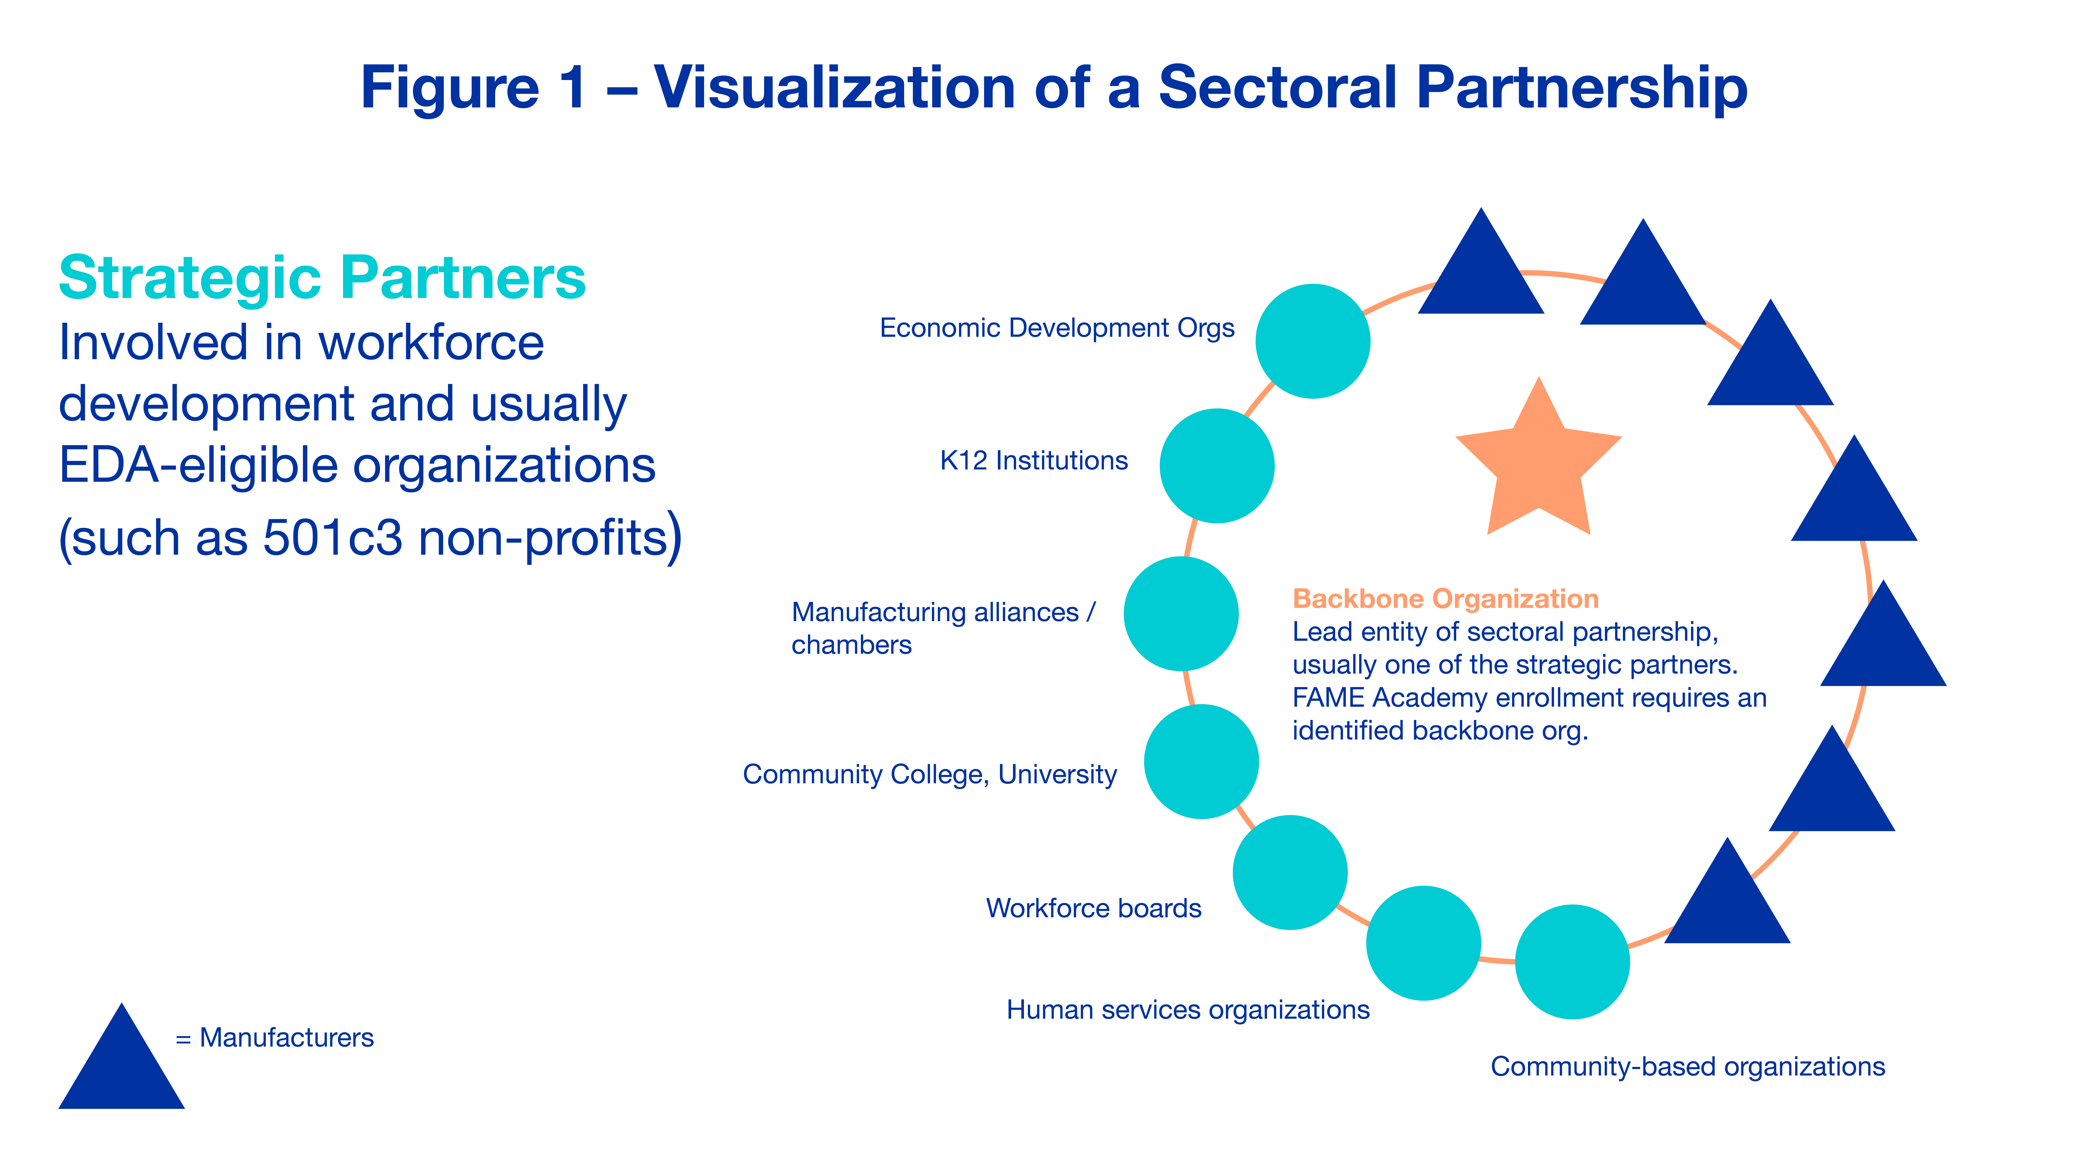
The Structure
The Structure

Slide 20
Integration + Collaboration

Slide 21
AEL Alignment

Slide 22
How Can We Help?
fame@nam.org

Slide 23
Guest Speaker
Adrian Lopez
Workforce Solutions Alamo

Slide 24
Workforce Solutions

Slide 25
System Alignment

Slide 26
AEL Strategic Plan
Goal 2: Address Demand with Increased Access
Objective 3: Increase employer, business community, and community-based organization roles in AEL
Action Items 1, 2, and 4
•WSA’s local plan has developed a sector-based model for supporting employers which in turn creates high wage, high demand careeropportunities for job seekers. (Action item 1: Promote engagement with business through workforce business development units and business-employer associationsto develop models that incorporate occupation-specific skills and work readiness requirements into AEL services.) oSector-Based Strategies.Sector strategies work to identify employer skill and workforce needs in a given industry cluster and region and develop recruiting, assessment, and training strategies to help employers find workers with the right skills.The following are examples of sector strategies:Industry Partnerships.Collaborations of businesses from a particular industry that meet regularly with the assistance of a workforce intermediary to address their region and industry’s collective workforce and talent needs.Includes discussions of shared human-resources issues, exchange of information about industry practices, and specific actions to address workforce challenges.
Sectoral Skills Partnerships.Bring together multiple employers within an industry to collaborate with colleges, schools, labor/workforce agencies, community organizations and other stakeholders to align training with the skills needed for that industry to grow and compete.Sector partnerships can help facilitate the advancement of workers at all skill levels, including the least skilled.
Regional Skills Alliances.These can take many forms.Broadly, they can be defined as collaborations within a regional labor market among multiple firms with similar labor market needs and other key stakeholders (such as labor, educational institutions, communityorganization, the public sector) to identify and address skills shortages.
Industry Skills Panels.Private/public partnerships work to ensure that employees in key industries have the skills needed to quickly and competently meet the changing needs of businesses.Harnessing the expertise of leaders in business, labor, education, economic development, and other sectors.Skill Panels bring competitors within a specific industry together to collaboratively address critical issues, skill gaps, training needs, and performance outcomes that affect the industry as a whole.

Slide 27
Who and How Overview

Slide 28
Who/ How

Slide 29
Board Strategic Vision
Sector-Based Partnerships

Slide 30
Talent Pipeline Management

Slide 31
WSA Local Plan Economic and Workforce Analysis
Target Clusters and Industries
Targets 2022-2024
Clusters | Industries
Aerospace/Manufacturing | 3361 Motor Vehicle Manufacturing 3363 Motor Vehicle Parts Manufacturing 3364 Aerospace Products and Parts Manufacturing
Health | 6211 Offices of Physician 6221 General Medical and Surgical Hospitals 6212 Offices of Dentists 6215 Medical and Diagnostic Laboratories
Information Technology/Cybersecurity | 5415 Computer Systems Design 5416 Management/Scientific, and Technical Consulting Services
Construction/Utilities | 2371 Utility System Construction
Oil & Gas/ Warehousing & Transportation/ Fiancé/other | 5221 Depository Credit Intermediation 2111 Oil & Gas Extraction 4931 Warehousing and Storage 2131 Support Activities for Mining
Education | 6111-ElementaryandSecondarySchools

Slide 32
Target Occupations 2021-2024
Target Occupations 2021-2024

Slide 33
Industry Sector Scorecard BCY23
Industry Sector
Scorecard
BCY23
Please note:
Information is YTD and reported live monthly, therefore, data consistently changes as enrollments in sector-based training increase and decrease, and credentials obtained month to
Timeframe:
10/1/2022 03/06/2023* Other;
includes all other industries

Slide 34
Business Services Unit Scorecard
Business Services Unit Scorecard
August 2022-March 2023

Slide 35
Employer Collaborative

Slide 36
Career Pathways

Slide 37
Rebranding of Centers

Slide 38
Rebranding of Centers Continued

Slide 39
Workforce Academy

Slide 40
Workforce Leadership Academy

Slide 41
Questions

Slide 42
AEL Committee Discussion
Presiding Officer – Steve Banta, Literacy Texas

Slide 43
Committee Next Steps
For the September Meeting:
Digital Equity Act (DEA) / Broadband Equity, Access, Deployment (BEAD) Program
  Amanda Bergson-Shilcock – National Skills Coalition
  Cynthia Fisher – Texas Broadband Office
Deeper Discussion About 2022 Recommendations
One Door
Statewide Needs Assessment

Slide 44
Closing Remarks

Slide 45
Next AEL Advisory Committee Meeting
Tentatively Scheduled:
September 27th, 2023

