Slide 1
Adult Education & Literacy Advisory Committee Meeting (Virtual)
Wednesday
March 15th, 2023 at 1:30 PM

Slide 2
MARCH 15TH, 2023 Agenda
TWC Welcome and Intros
State Director Opening Remarks
Commissioners Remarks
TWC AEL Updates
Legislative Updates
III. Committee Business and Discussion
Presentations
Hannah Gourgey, PhD - Aspen Institute, Texas Opportunity Youth Network
Tabitha Smith-Moore, Programs Oversight Unit Director, Workforce Solutions Tarrant County
Committee Discussion

Slide 3
Opening Remarks
Advisory Committee Memberships Expiring April 2023
Thank you Brenda Schofield and Rita Hernandez for your invaluable service

Slide 4
Opening Remarks Continued
We will be bringing forward some new member recommendations for the Commission to consider in April

Slide 5
Commissioner Remarks
Chairman Daniel
Commissioner Demerson
Commissioner Trevino

Slide 6
TWC AEL Updates
Legislative Updates
Mahalia Baldini, TWC AEL Director

Slide 7
Legislative Items
House Bill(HB) 1602, Guillen
Relating to performance criteria for the award of adult education and literacy funds
Notes:
Would amend statute language that would require the Commission to set performance criteria comparable to current performance incentive funding
Prioritize funding based on who is meeting criteria

Slide 8
Adult High Schools
SB 2032
Relating to the authorization of certain adult high school charter school programs
Notes:
This bill would amend Education code and add a section to Chapter 12, Sub Section G, creating an alternative authorization process for becoming a state recognized adult charter high school. The new section and language would allow home schools (secondary), public schools (both secondary and post-secondary), and government organizations to apply for adult charter school status and funding as long as they do so in conjunction with a non-profit entity.

Slide 9
More To Watch
HB 4631/Senate Bill (SB) 2139
Relating to the creation of the Opportunity High School Diploma pilot program
Notes:
Amend Education Code, Chapter 12, add sub section K-1
Pilot to study alternative means by which an adult student may earn a high school diploma from a public junior college through a competency-based educational program equivalent to a Foundation School Program. The Texas Higher Education Coordinating Board(THECB) consult with the Texas Education Agency (TEA) and Texas Workforce Commission (TWC) during the development and implementation of this pilot program

Slide 10
Roll Call Advisory Committee
Member | Location | Representing | Affiliation | Term Expires
Steve Banta (Presiding Officer) | Dallas/ Fort Worth | Nonprofit | Executive Director, Literacy Texas | December 2023
Rita Hernandez | Brownsville | Nonprofit/ Career School | President, Cameron County Education Initiative | April 2023
Jauneen Maldonado | Fort Worth | Workforce Board | Director, Adult Education, Workforce Solutions for Tarrant County | December 2023
Brenda Schofield | Beaumont | AEL Provider | Director of Adult Education and Literacy, Region 5 Education Service Center | April 2023
Leslie Cantu | San Antonio | Business | Asst. Vice President, Toyotesu | October 2024

Slide 11
Committee Presentations
First Presenter Hannah Gourgey, PhD Second Presenter Tabitha Smith-Moore

Slide 12
Texas Opportunity Youth (Agenda)
Overview of Texas Opportunity Youth
Introduction Texas Opportunity Youth Network
High-Level Examples of Effective OY Pathways

Slide 13
Texas Opportunity Youth
Hannah Gourgey, Ph.D.
Senior Fellow
Aspen Institute’s Opportunity Youth Forum
Hannah.Gourgey@aspeninstitute.org

Slide 14
Who are Opportunity Youth
Aged 16-24, not in school, not in college or postsecondary, not in work, or working in low-wage, dead-end jobs
Nationwide, there are over 5 million opportunity youth and young adults

Slide 15
Opportunity Youth in America
14%
Source: https://www.measureofamerica.org/DYinteractive/#National

Slide 16
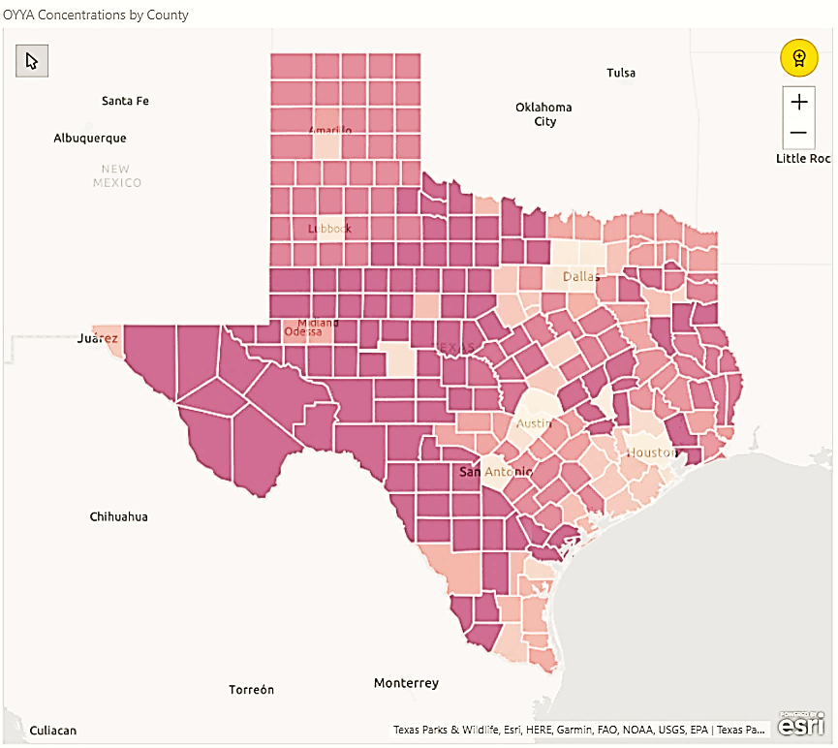
1 in 10 US Opportunity Youth are Texan =500,000+
An estimated 100,000 of these young adults have not completed high school
Amarillo
Lubbock
Dallas/Ft. Worth
El Paso
Midland/Odessa
Waco
San Augustine
Austin
Jasper
San Antonio
Houston
2016 Texas share of county population’s 16-24-year-olds who are
Opportunity Youth
Source: https://measureofamerica.org/disconnected-youth/# :& US Census Data, Texas Public Use Microdata Samples by PUMA 2016; 16-24 YO not in school or work , County map prepared by Educate Texas, 2018
3%
27%
Brownsville, McAllen

Slide 17
Why Support for Texas OY Matters…
Annual financial return to Texas taxpayers is $7.1 billion
Annual social impact return to Texas is $19.1 billion
Solving OY system challenges strengthens education & workforce training for ALL young Texans and meet the goals of Building a Talent Strong Texas
Source: https://www.measureofamerica.org/DYinteractive/#State and https://aspencommunitysolutions.org/wp-content/uploads/2018/07/Economic_Value_of_Opportunity_Youth_Report.pdf
:

Slide 18
Out of School Youth Rate has Increased Sharply in Texas
Source: https://www.dallasfed.org/cd/communities/2022/0124

Slide 19
High School Disconnection
In 2021, almost 40,000 Texas students in grades 9-12 dropped out of high school
For our low-income teens, that’s 1 in every Texas classroom of 35 students
High school dropouts have just a 12% chance of earning a living wage in the Texas economy
Returning our recent dropouts to our schools would help forge a talent strong Texas and add close to $400 million to our public education funding
Sources: https://rptsvr1.tea.texas.gov/acctres/drop_annual/2021/state_demo.html, E3 Alliance economic prediction of HS earnings & Federal Reserve Bank of Dallas Report https://www.dallasfed.org/~/media/documents/research/swe/2019/swe1903d.pdf
:

Slide 20
22% of 8th Graders Completed a PS Credential: HS is the First Barrier
68091
105409
107612
Source:
These findings derive from data sets prepared by the Texas Higher Education Coordinating Board’s 8th Grade Cohort Monitoring Project for 2012 8th Graders tracking postsecondary completion rates (certificate, 2-yr, 4-yr) for up to 6 years after high school graduation

Slide 21
Black, Hispanic and American Indian Males Experience the Highest Rates of HS Disconnection
Drop Out Rate for Class of 2021
Source:
Texas Education Agency: https://tea.texas.gov/sites/default/files/dropcomp-2020-21.pdf

Slide 22
Texas Opportunity Youth Network

Slide 23
The Texas Opportunity Youth Network
Texas OY Leadership Council
Texas Emerging Leaders Board
Texas Community of Practice
Leverage Texas Systems to Optimize Texas Systems
Build & Scale Pathways from Robust Data Insights and Progress Monitoring
Provide input and insight into the Young Adult Texans experience
Co-design & lead strategies and policies most supportive of Texas Opportunity Youth
Innovation Fund Planning Phase Partners
Collaboratives focus on building capacity to scale best practice, positive youth programming by leveraging Texas policy and public funding
Total OY = 277,650 or 64% of State’s OY
OYF & TOYN Member
TOYN Member

Slide 24
Innovation Fund
Build Expertise and Capacity for OY Providers to develop blended revenue models
Develop OY pathways aligned to regional labor markets
Cultivate OY-centered best practices leading to HS completion, PS completion and career entry

Slide 25
Models Leveraging Inter-agency Funding
CIS-ISD/CBO/Higher Ed Partnerships
Leverage ADA/Ability to Benefit/AEL
WIB-ISD/Charter Partnerships
Leverage ADA/McKinney Vento/WIOA
Municipal-Higher Ed/ISD/CBO Partnerships
Leverage ARPA, Ability to Benefit, AEL, ADA

Slide 26
Effective OY Strategies & Pathways

Slide 27
Lessons Learned in Effective OY Pathways
DEDICATED STAFF NEEDED FOR LIVED EXPERIENCE EFFORTS
YOUNG ADULT ENGAGEMENT REQUIRES A FOCUS ON THE WHOLE PERSON
Programs and Pathways must cultivate belonging and Purpose
PLANNING PERIOD ESSENTIAL TO SUCCESSFUL LAUNCH OF STRATEGIES
System level collaborative work – essential and complex
Source: Greater Houston Opportunity Youth Council, 2023

Slide 28
Effective Pathways Offer Multiple Entry Points and Choice
Re-Engagement with Co-location
Basic Needs & Belonging, Purpose
HSE /Alternative HS Enriched Academic Prep
Postsecondary/Career Navigators
Work Readiness & Work-based Learning
Postsecondary Bridging & 1st Year Supports
Industry Certification/PS credential

Slide 29
Considerations for AEL
In the wake of the pandemic, how might the upcoming AEL RFP address an increased need to focus on youth & young adults most impacted by learning loss and high school disconnection?
How might AEL encourage and promote the leveraging of funding across agencies to optimize the use of public dollars and scale programs and pathways? What agency or grantee practices will need to be in place?
What agency strategies might promote leveraging TEA accountability changes for Dropout Recovery and amplify supports for postsecondary bridging and co-enrollment?
How might AEL encourage the diversification of partnerships to include programs best suited to re-engage and support opportunity youth and young adults?

Slide 30
Collaboration that works!
Collaboration That Works!

Slide 31
Presenter
Tabitha Smith-Moore, Programs Oversight Unit Director, Workforce Solutions for Tarrant County

Slide 32
Partners::
Workforce Solutions for Tarrant County – WIOA Youth Program
Goodwill Industries North Central Texas
Fort Worth Independent School District – Adult Education and Literacy

Slide 33
What is E Squared?
E-Squared (E2) is a program specifically for youth and young adults in Tarrant County who are out of school, aged 16-24, and that are experiencing barriers to employment and education. The E-Squared Program provides High School Equivalency preparation courses taught by state-certified Fort Worth ISD and Tarrant County Adult Education and Literacy instructors, paid work experience funded by Workforce Solutions for Tarrant County, individualized mentoring and coaching, life and job readiness courses, as well as connections to further employment and education opportunities.

Slide 34
Who Does E Squared Serve?
Out of School Youth 16 to 24
With out/ HS Diploma
Drop-outs
Court Ordered Youth
Resides in Tarrant County

Slide 35
Common Grounds Outcomes
Benefits
More resources for Young Adults 16 to 24 without a high school diploma or GED.
Case management
Support services (transportation, childcare, testing fees)
Tracking (shared performance)
Paid Work Experience
All elements of the program happens in one place.
Youth stay engaged.
Better attainment rates

Slide 36
The Model:
Participate in FWISD/AISD HSE class on Monday through Thursday, 8:30 – 11:30 a.m.
Participate in the paid work experience from 12:30 – 3:30 p.m.
Friday’s youth participate in life skills/job readiness 8:30 – 11:30 a.m.
Additional study/review or WEP hours from 12:30 – 3:30pm.
A one-hour lunch break will take place daily from 11:30 a.m. – 12:25 p.m.

Slide 37
Co-enrollment - Staffing
Youth Specialist (full-time Goodwill Industries Staff )
Outreach and Recruitment
Worksite Monitoring
Scheduling HSE Testing
Documenting service in TWIST
Pays WE Wages
WIOA Career Counselor (full-time Workforce Center Staff)
Provide Wrap Around Services/Case Management
Industry Expert
Shared duties with Youth Specialist
Determines eligibility
Documenting service in TWIST
Provides Support Services
Instructor ( Full or Parttime FWISD )
Prepare Youth for HSE
Provide Casas Assessment
Notes:
AEL provides a career navigator and the Center provides a Career Counselor that is dedicated to the co-enrollment model. This ensures that both staff understand the requirements from each side.

Slide 38
How is this funded?
WIOA Title 1 local youth funds pays Youth Salaries and support Services tied to program Participation.
WIOA Tile II Pays for Instructors Salaries.

Slide 39
Targets and Outcomes
E Squared Customer Served Target per program year is 60 WIOA Youth.
Overall the program has served 383 since 2017.
From October 1, 2021 to September 2022 14 has received their HSE. (It was our first year to do GED only after Hiset ended)
October 1, 2022 to current there are 37 enrolled and 11 has
received their HSE.

Slide 40
Success Stories: Dylan Stokes
Dylan Stokes came into Goodwill North Central Texas’ Education and Employment program when he was 16 years old. Since junior high Dylan struggled with attending his classes and staying out of trouble. Dylan tried to improve but felt like he was being judged, being treated differently from his other classmates due to his record and didn’t really have a good support system. Things didn’t get better when he attended high school, as he didn’t get along with the other students and stopped attending school. Due to all his absences, Dylan was then mandated to attend Truancy court Precinct 2 where he would meet Judge Mary Tom Curnutt. With Dylan being so far behind due to being truant, the Judge then ordered Dylan to enroll into a GED program. Dylan’s Parole officer, Diane Hunt then referred him to Goodwill North Central Texas’ Education and Employment program. Dylan came in for testing and was recommended with high CASAS scores. Dylan had the goal to graduate as quickly as possible but would soon realize that it would take a lot of hard work. Dylan had to do a lot of studying both in the classroom and at home and would sometimes start to get impatient.
Dylan successfully completed the E² program on February 16th. When he received his certification, Dylan, his mom, P.O, and youth staff went to the justice of peace court and Dylan presented his certification to Judge Curnutt. When joining the program, Dylan thought that he would just be going to class doing his own thing but was surprised at how much support he got from the youth staff, workforce, and his instructor. Everybody was always checking up on him and kept him motivated especially when he started to get impatient. Dylan also liked that it was a 2-part component program, and he was able to get paid work experience.
Dylan said that joining the E² program had changed his life so much and if he never found this program he would have continued getting into trouble and eventually locked up. Dylan’s future goals include joining the Navy, attending TCC in the fall, and obtaining employment.

Slide 41
Success Stories: Alicia Murphy
Prior to Goodwill, Alicia Murphy held several jobs in various warehouse and waitressing positions, but what she really wanted was financial stability. Working in warehouse was draining her both mentally and physically-she knew she needed to further her education in order to kick start her career. Alicia had the drive to succeed, but like many people lacking education and work experience, she felt lost. She strived for independence, finding financially stable employment, and her own place to live. Knowing that she could not do this without first qualifying for higher wage jobs, Alicia made the decision to go back to school and earn her high school equivalency.
Alicia was referred to Goodwill's E2 program in December 2018, determined to obtain her high school equivalency and begin her path towards independence. And that is exactly what she did. While Alicia began her journey simply seeking to obtain her high school equivalency, her plans quickly changed when she learned about all of the other opportunities Goodwill offered. When Alicia discovered that Goodwill's Career School, North Texas Institute (NTI), offered courses and certification opportunities in the medical industry, she became even more enthusiastic and determined. Alicia quickly redirected her focus. Determined to start a career in the healthcare industry, Alicia enrolled in Goodwill's Medical Front Office Assistant program in June 2019, and by November 2019 she had passed her national certification exam. Alicia did not stop there, however, and in January 2020 she enrolled in Goodwill's Medical Billing & Coding program, determined to earn a second credential, all while working a full-time job as a Dock Worker with Goodwill. In November 2020, Alicia successfully completed the program and passed her national exam, earning a second credential that she was hopeful would give her a jumpstart in the healthcare industry.
Upon completing her two credentials, Alicia faced some difficulties finding a job placement in the healthcare industry. This was not for a lack of trying, but rather having no experience in the healthcare industry. She did not let this deter her, however, and remained determined. Alicia worked with her Business Developer to update her resume, complete job readiness training, and participate in mock interviews. Finally, in November 2020, Alicia landed a 3-month internship with the City of Arlington. While this internship was not health-industry related, Alicia knew it would still be extremely beneficial for her as it would give her experience in an office environment.
A week before her internship ended, Alicia called her Goodwill business developer stating that she was ready to start her job search again and find something in the healthcare field.
Determined, Alicia came back to Goodwill to update her resume and immediately begin filling out job applications. In February 2021, Alicia's determination paid off and she began working full-time as General Clerk with the Tarrant County Health Department making $15.84/hour.

Slide 42
Questions!

Slide 43
Committee Discussion
Presiding Officer, Steve Banta

Slide 44
Next AEL Advisory Committee Meeting
Tentatively Scheduled: June 15, 2023

