Slide 1
Advisory Committee Meeting
Wednesday
December 6th, 2023 @ 1:30 pm
TWC- Adult Education and Literacy
Notes:
The blank slides in this presentation are there to show you the layout options. Feel free to delete slides you do not want or to change the layout of the slides (right click then choose Layout from the menu).
To change the slide background picture or TWC logo on this slide, go to View > Slide Master

Slide 2
December 6th, 2023
Agenda
TWC Welcome /Opening Remarks
TWC AEL Updates
Committee Business and Discussion- Steve Banta - President
      Committee Discussion – 2023 Report
        Collaboration Between Agencies
        Collaboration with Community Based Organizations
        Integrated Education & Training Model

Slide 3
Welcome & Opening Remarks

Slide 4
TWC Updates

Slide 5
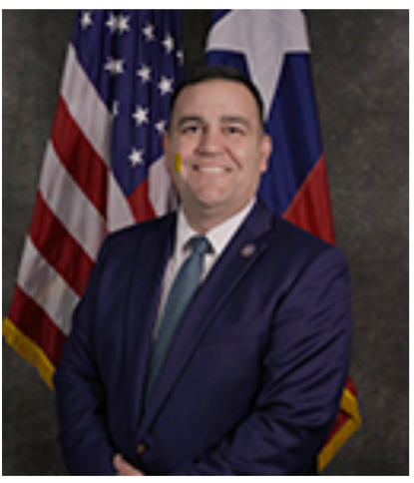
Welcome New Commissioner Representing Employers
Joe Esparza
Former Texas Deputy Secretary of State. In addition, Esparza previously served as a Senior Appointments Manager in the office of the Governor.
https://www.twc.texas.gov/agency/commissioners/employers

Slide 6
Statewide Competition Is Published
$80 Million grant
Statewide services to over 70,000 eligible individuals
A Few Key Changes To the Service Design
  OCTAE requirements
  Legislative requirements
Increase in # of grants
Applications are due 12/22/2023
Award start date 7/1/2024

Slide 7
Farewell To Members
Steve Banta – Presiding Officer
Final PO Act: Annual Committee Report in January

Slide 8
End of Year Report
Due no later than January 31st – look back
Presiding Officer will address the Commission
Can include information related to Advisory Committee discussions and/or any recommendations you feel are relevant to the Commission

Slide 9
AEL Committee Discussion
Presiding Officer- Steve Banta, Literacy Texas

Slide 10
AEL Advisory Committee
Member | Location | Representing | Affiliation | Term Expires
Steve Banta (Presiding Officer) | Dallas/ Fort Worth | Nonprofit | Executive Director, Literacy Texas | December 2023
Dr. Ben Stafford | Port Arthur | Higher Education | Vice President, Workforce and continuing Education | May 2025
Jauneen Maldonado | Fort Worth | Workforce Board | Director, Adult Education, Workforce Solutions for Tarrant County | December 2025 (TBD)
Cindy Fisher | Austin | Texas Broadband Office | Senior Coordinator, Texas Broadband Office | May 2025
Leslie Cantu | San Antonio | Business | Asst. Vice President – Toyotesu | October 2024
Kristina Hartman | Huntsville | Corrections Education | Superintendent, Windham School District | May 2025

Slide 11
Discussion Points
Collaboration Between Agencies
Collaboration with Community Based Organizations
Integrated Education & Training Model

Slide 12
Closing Remarks

Slide 13
Next AEL Advisory Committee
Meeting
Tentatively Scheduled:
TBD

